Slide 1
What movie do you want to watch next?
Note: this yellow box format indicates working notes for the team to serve as reminders
predicting movie success using Movies MARK®

Slide 2
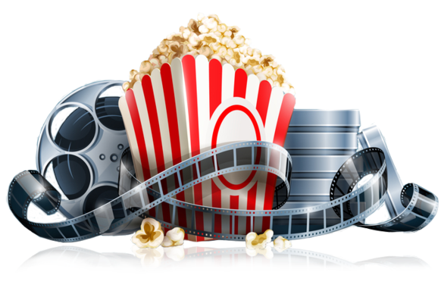
Everyone loves movies.
Streaming has reshaped cinema and the COVID-19 pandemic has left many of us wondering “what should we watch next?”
Using data-wrangling, programming, and machine learning skills, we plan to answer:
What makes movies successful?

Slide 3


Our MARK Team
of budding Data Scientists collaborated virtually across Zoom and Slack (as “the_clever_crew”) to bring you this fine work.
Maggie Allen Presentation + GitHub + Dashboard
Andrew Malony GitHub + Graphs + Dashboard
Rose Baumann Database + Data Clean-up
Kathy Morrissey Data Clean-up + Machine Learning Model

Slide 4
But first we must ask
How do we define Movie Success?

Slide 5
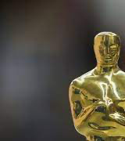
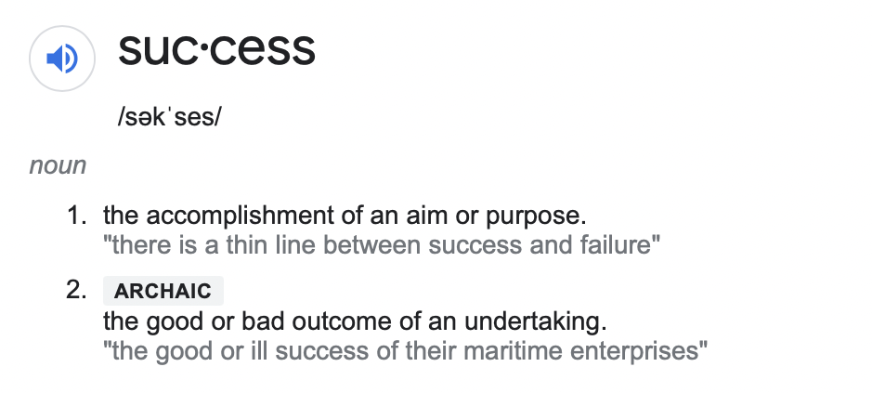
The Google Translate app can repeat anything you say in up to NINETY LANGUAGES from German and Japanese to Czech and Zulu

Slide 6
The Google Translate app can repeat anything you say in up to NINETY LANGUAGES from German and Japanese to Czech and Zulu
Popularity (Proprietary ratings, User Ratings)
Estimated Profitability (Revenue-Budget)
Awards
sadfasdfa

Slide 7

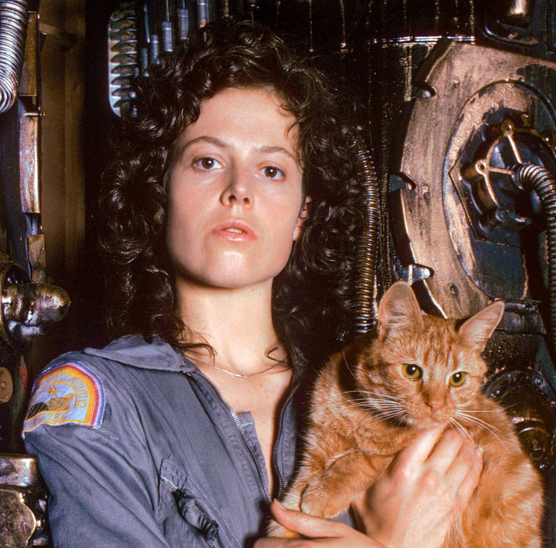
Meet Ellen.
She is the owner of a new start up streaming service, Serenity Streaming. She’s looking to use AI and Machine Learning to help connect users with their favorite movie they have never even heard of.
Right now she’s still working out of her home office and realizes despite a ton of data, she needs a proof of concept machine learning model to get investment interest.

Slide 8

Meet Sam.
Sam is a newly promoted executive at ABC Movie Productions and is interested in determining the right mix of movie genre, Director’s talents, and A-list actors are going to be the recipe for the next blockbuster.
Before him, the boomers were sitting in rooms making all the calls but he thinks data science can flip the script.

Slide 9
Meet Steel.
He recently had a baby so he has no time to watch a bunch of bad movies. When he finally has a free evening, he wants the first movie he streams to be one he’s happy to talk about with his new baby boy.
Let’s see what he should look for in his next popcorn night’s entertainment...

Slide 10
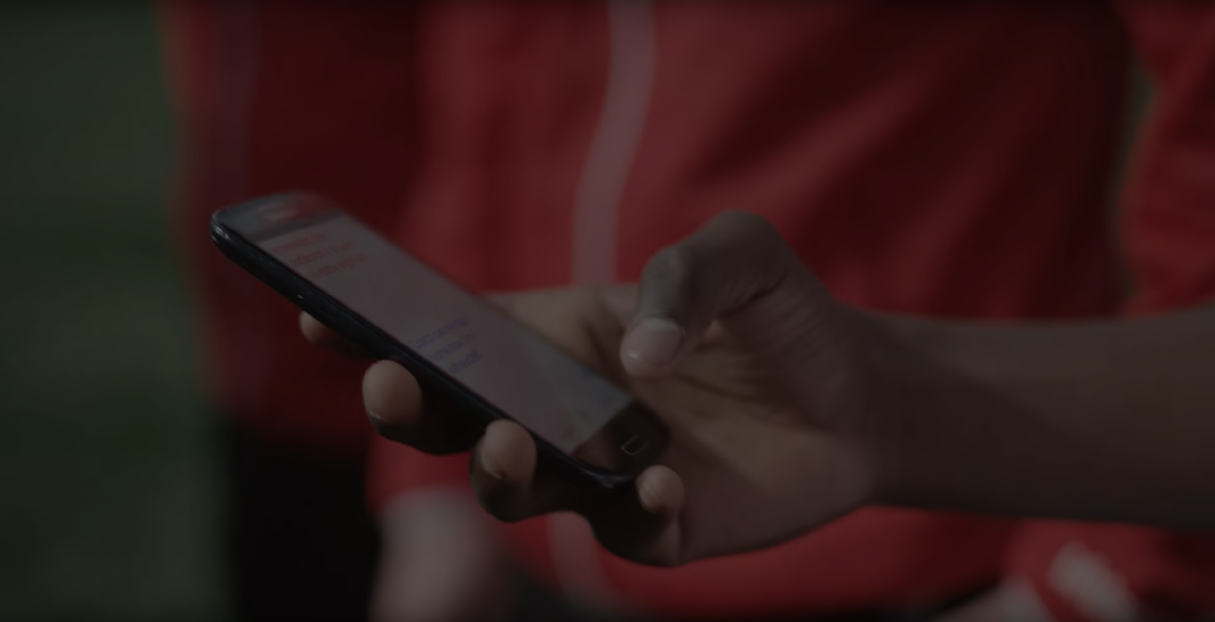
Whatever our solution will suggest, we should summarize here.

Slide 11

Then, Steel discovered Movies MARK®
Now he can use our simple list of factors to determine if this is a movie he would be happy to watch..

Slide 12

Our Data
Internet Movies DataBase (IMDb)
The Movies DataBase (TMDB)
Kaggle Movies DataSet
1970+
Source: https://www.imdb.com
https://www.themoviedb.org/?language=en-US
https://www.kaggle.com/rounakbanik/the-movies-dataset

Slide 13
Placeholder for Dashboard Slides + Interactive Graphs

Slide 14
Clever saying to finish us off on a note with a touch of humor..
Some sort of summary bullet of interest.

Slide 15
Thank you.

Slide 16
APPENDIX

Slide 17
Link to Repository
Link to ReadMe.md file
Link to Profile Report

Slide 18
Pretty Graphs
October 2020
October 2021
August 2021
November 2021
A trigger to kick us off
Timing of an event
2020 |  |  |  | 2021
Something interesting
Moment of consideration

